Slide 1
Revolutionizing Indoor Air Quality; Aeris Lite
What-If you could transform your living spaces into healthier environments? Discover how advanced technology can make it possible.

Slide 2
The Importance of Indoor Air Quality
Health Impacts:
  Respiratory Health: Poor indoor air quality can exacerbate asthma, allergies, and other respiratory conditions.
  Cardiovascular Health: Prolonged exposure to pollutants like PM2.5 is linked to cardiovascular diseases, including heart attacks and strokes.
  Overall Well-being: Good air quality contributes to better sleep, reduced stress, and overall improved physical and mental health.
Productivity and Performance:
  Cognitive Function: Elevated levels of CO2 and other pollutants can impair cognitive function, affecting concentration, decision-making, and productivity.
  Employee Performance: Clean air promotes a healthier work environment, reducing sick days and increasing overall productivity.
Comfort and Well-being:
  Indoor Comfort: Proper humidity and temperature control are essential for comfort and preventing issues like mold growth.
  Occupant Satisfaction: Good air quality leads to higher satisfaction among building occupants, whether in homes, offices, or public buildings.
Long-term Economic Benefits:
  Healthcare Costs: Reducing exposure to indoor pollutants can lower healthcare costs associated with treating respiratory and cardiovascular conditions.
  Building Maintenance: Effective air quality management can prolong the lifespan of HVAC systems and reduce maintenance costs.
Regulatory Compliance:
  Health and Safety Standards: Adhering to indoor air quality standards helps ensure compliance with health and safety regulations.
  Sustainability Goals: Meeting air quality standards contributes to sustainability and environmental goals, including certifications like WELL and LEED.
Special Considerations:
  Vulnerable Populations: Children, the elderly, and individuals with preexisting health conditions are more susceptible to the effects of poor air quality.
  Healthcare Settings: Maintaining high air quality standards is critical in healthcare settings to protect patients with compromised immune systems.

Slide 3
Challenges in Maintaining Indoor Air Quality
Pollutant Sources:
  Outdoor Pollution: Traffic, industrial emissions, and construction dust can infiltrate indoor spaces.
  Indoor Activities: Cooking, cleaning, and smoking can introduce harmful particulates and gases.
  Building Materials: Off-gassing from paints, furniture, and carpets can release volatile organic compounds (VOCs) and formaldehyde.
Ventilation Issues:
  Poor Ventilation: Inadequate airflow can lead to the accumulation of pollutants.
  HVAC System Maintenance: Regular maintenance is required to ensure filters and ducts are clean and functioning properly.
  Energy Efficiency vs. Air Quality: Balancing energy-saving measures with adequate ventilation can be challenging.
Occupant Behaviour:
  High Occupancy: More people can increase CO2 levels and spread pollutants.
  Inconsistent Practices: Irregular cleaning and maintenance routines can lead to fluctuating air quality.
Environmental Factors:
  Weather Conditions: High humidity and temperature can exacerbate indoor air quality issues.
  Seasonal Variations: Different seasons can bring varying levels of pollen, mold, and other allergens.
Detection and Response:
  Lack of Monitoring: Without real-time monitoring, it’s difficult to detect and respond to air quality issues promptly.
  Delayed Action: Without immediate alerts and actionable data, responses to deteriorating air quality may be too slow.
Regulatory Compliance:
  Adherence to Standards: Ensuring compliance with local and international air quality standards can be complex.
  Continuous Updates: Staying updated with evolving regulations and standards requires constant attention.

Slide 4
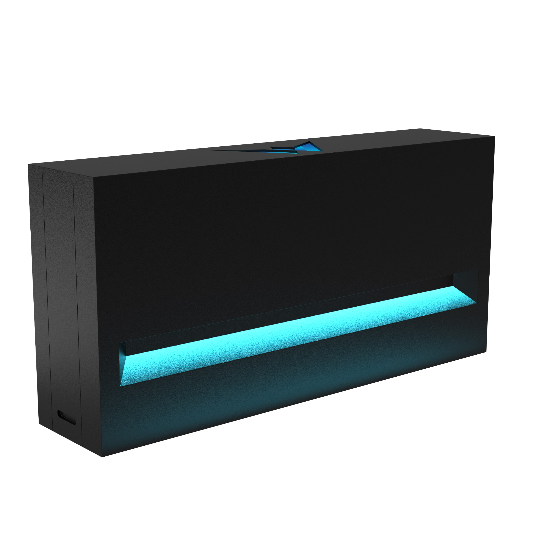
Aeris Lite
  Real-time air quality Monitoring: Continuous air quality data.
  Real-time LED colour visual Alerts: Visual alerts with adjustable settings.
  Offline Data Storage: Ensures data integrity during connectivity interruptions.
  User-friendly Interface mobile application: Intuitive and easy to navigate.
  Configurable Automations: Automated control for compatible integrations.
  Alerts and Notifications: Immediate notifications for any air quality issues.
  Easy-to-read Dashboard: Clear and concise real-time data display.
  Data export: Easily export detailed air quality data for compliance, analysis, and record-keeping.
  API Integration: Seamless connection to Building Management Systems (BMS) for enhanced HVAC and lighting compatibility.
  Zigbee/Thread ready*: Supports advanced connectivity for integrated control.
  Future Proofing: An add-on slot for additional sensors and peripherals ensures that IAQ monitoring systems can evolve with emerging technologies and changing needs.
  Global standards and framework: Compliance with international air quality standards and frameworks.
  Cybersecurity and Certification: Robust data protection and certified under Singapore’s Cybersecurity Labelling Scheme.
  Developed in Singapore: Innovation and engineering excellence from Singapore.
  Sustainable in mind: Made from sustainable materials, ensuring environmental responsibility without compromising quality.
Aeris Lite
*Applicable to Model Aeris+ only

Slide 5
Real-time air quality monitoring
Sensors | Range | Resolution | Accuracy | Technology
Temperature | -40°C to 100°C | 0.1 | ± 1°C | Micro-electromechanical
 |  |  |  | system (MEMs)
Relative Humidity | 0 to 100% | 0.1 | ± 3% | Micro-electromechanical
 |  |  |  | system (MEMs)
PM2.5 | 0 to 999 ug/m3 | 1ug/m3 | ± 10ug/m3 (0 to 100) | Laser Scattering
 |  |  | ± 10% (100 to 1000)
PM10 | 0 to 1000ug/m3 | 1ug/m3 | ± 10ug/m3 (0 to 100) | Laser Scattering
 |  |  | ± 10% (100 to 1000)
TVOC | 0 to 5000ug/m3 | 1ug/m3 | ± 25% | Metal Oxide Semiconductor (MOS)
Carbon Dioxide | 400 to 5000ppm | 1ppm | ± 3%+50ppm | Non-Dispersive Infrared (NDIR)
Formaldehyde | 0 to 2000 ug/m3 | 1ug/m3 | ± 10% | Electrochemical
LED | 16M colour addressable
Connectivity | Wi-Fi 2.4ghz Zigbee/Thread ready*
Power | USB-C 5V
Aeris Lite features industrial-grade indoor air quality sensors designed for long-term use, ensuring continuous monitoring data.

Slide 6

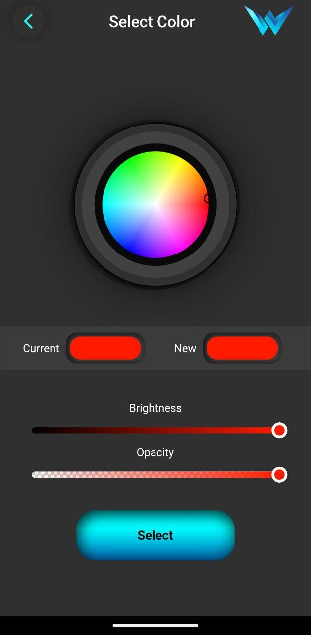
Real-time LED visual Alerts:
By employing high-quality addressable LEDs capable of displaying 16 million colours, Aeris Lite can visually alert users to indoor air quality conditions.
Default predefined threshold
  Aeris Lite will flash red
    If CO2 is above 2000ppm
    If Formaldehyde is above 200ug/m3
    If TVOC is above 1000 ug/m3
    If PM2.5 is above 100
    If PM10 is above 100
  Aeris Lite will flash amber
    If CO2 is between 1200-2000ppm
    If Formaldehyde is between 100-200ug/m3
    If TVOC is between 500-1000
    If PM2.5 is between 38-100
    If PM10 between 38-100
  In clear air conditions, Aeris will light up turquoise indicating healthy air quality.
User can also set threshold automation depending on critical parameter together with custom LED colour.
Aeris Lite
Mobile application:
colour selection page

Slide 7
Offline data storage
Aeris Lite ensures continuous air quality monitoring by storing data in its internal memory during network outages. This feature caches one-minute sensor data averages while offline. Upon reconnection, the stored data is uploaded to the Aeris server for processing and subsequently displayed on the Aeris Lite dashboard and mobile app, completing trend lines. This functionality is available exclusively for cloud connectivity via Wi-Fi.
The maximum backfill period is 5 days. Once the limit is reached, the oldest data will be overwritten minute-by-minute, on a rolling basis.

Slide 8
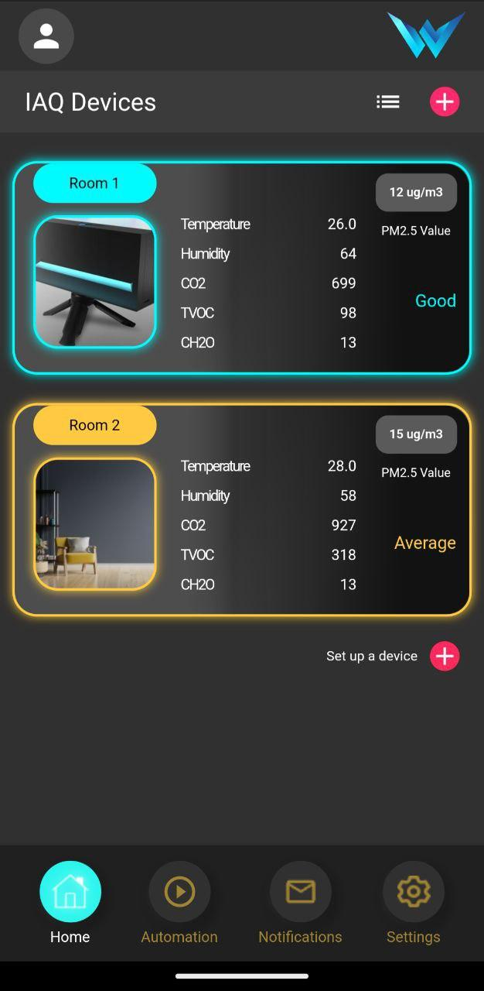
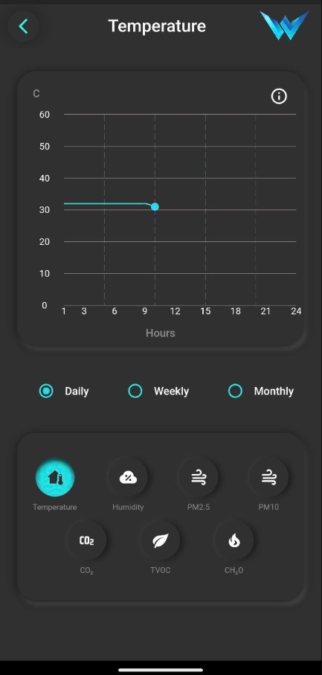
User-friendly Interface mobile application
Real-Time Monitoring: Visual representation of current air quality parameters including CO2, PM2.5, and other key metrics.
Historical Data: Graphical charts showing trends over time, allowing for analysis and prediction of indoor air quality changes.
Alerts and Notifications: Instant alerts via the Aeris Lite app for critical thresholds.
Automations: Ensures prompt action to maintain optimal indoor air quality.
Mobile application screenshots

Slide 9
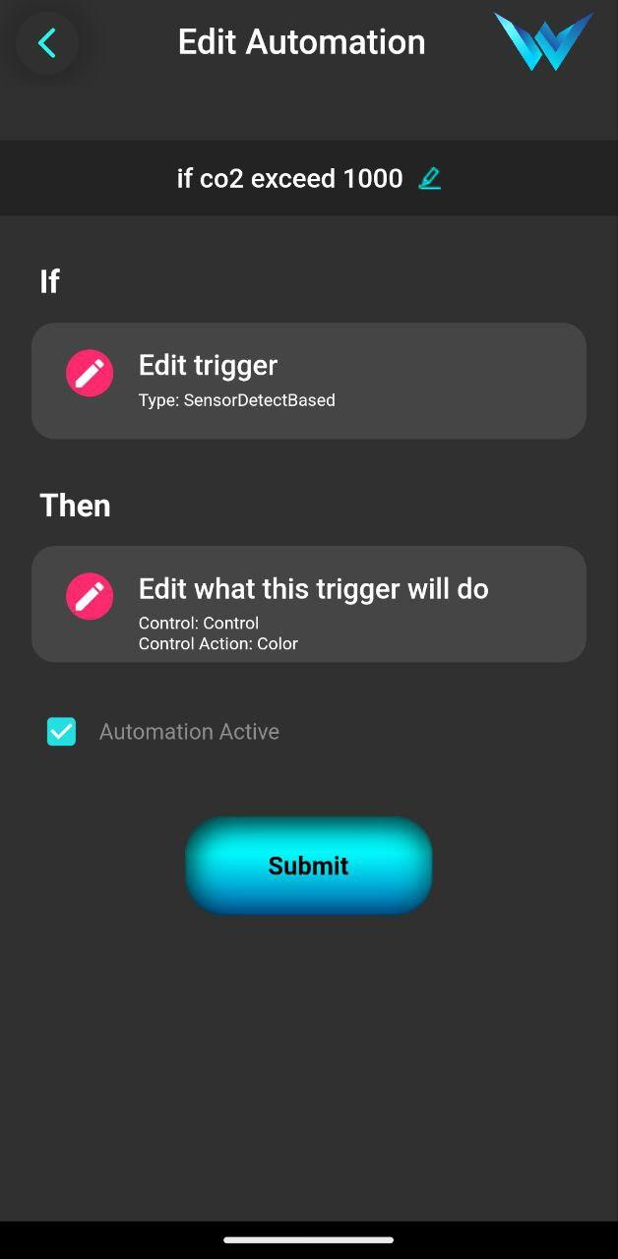
Configurable Automations
Aeris Lite offers advanced configurable automation that allows users to create custom rules for controlling compatible devices and systems. Using an intuitive "if trigger then control" logic, you can automate responses based on specific air quality conditions. This functionality enhances the capability of the Aeris Lite system, providing seamless integration with your building's environmental controls.
Example Automation Scenarios:
If CO2 Levels Exceed 1000 ppm, Then Increase Ventilation: Automatically activate the HVAC system to improve air quality when high CO2 levels are detected.
If PM2.5 Levels Rise Above 35 µg/m³, Then Turn on Air Purifiers: Ensure immediate action to reduce particulate matter and maintain a healthy indoor environment.
Mobile application: automation screenshot

Slide 10
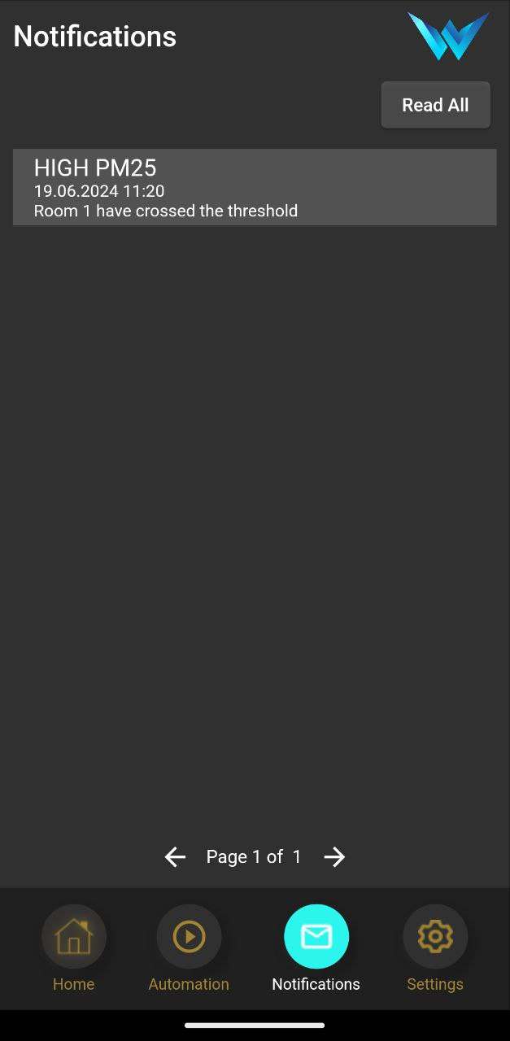
Alerts and notification
User can set automations to receive observed threshold criteria and receive pop-up notification on mobile phone.
Record of notification is also stored and presented on mobile app.
Mobile application:
Record of notifications

Slide 11
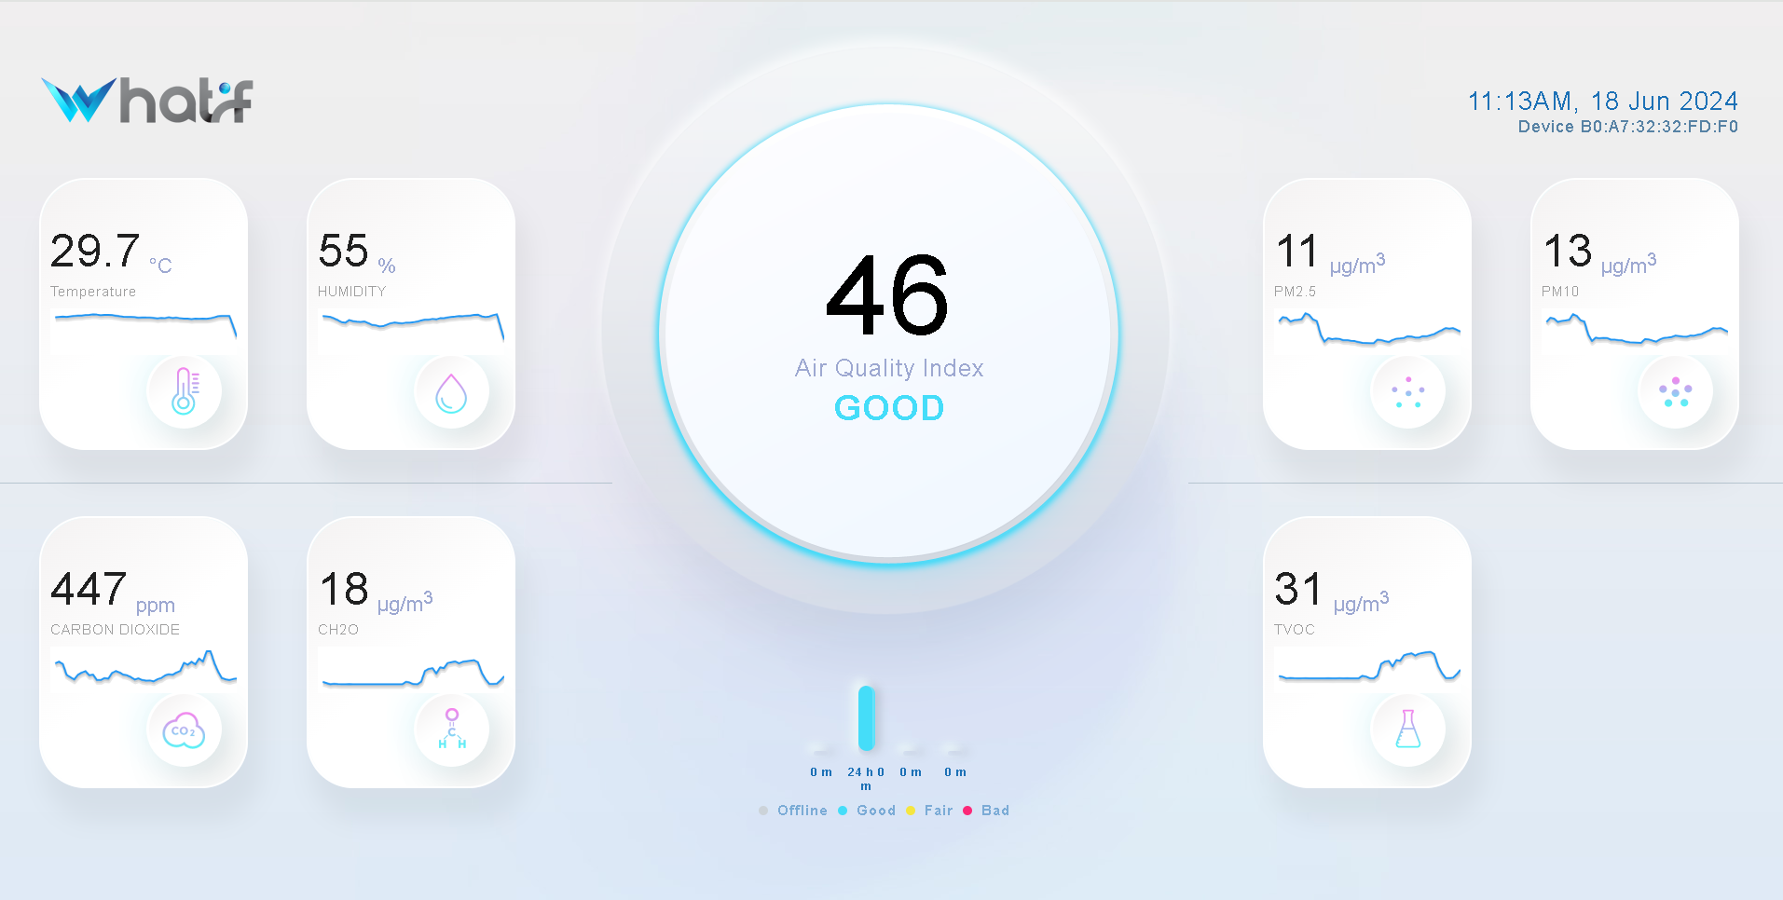
Easy-to-read Dashboard
Real-Time Monitoring: Visual representation of current air quality parameters including CO2, PM2.5, and other key metrics.
Historical Data: Graphical charts showing trends over time, allowing for analysis and prediction of indoor air quality changes.
Clear Alerts: Visible alerts on the dashboard for critical thresholds, ensuring immediate action to maintain optimal indoor air quality.
Accessible via any internet-connected display device such as Smart TV, Tablet, Mobile Phone.
Personalized Layouts Available Upon Request.
Default dashboard

Slide 12

Data export
Aeris Lite also supports robust data export capabilities, allowing users to extract detailed air quality data for further analysis and reporting. Data can be exported in CSV format, making it easy to integrate with third-party applications and systems. This feature is ideal for users who need to maintain compliance with regulatory standards, conduct in-depth environmental studies, or simply keep comprehensive records of their indoor air quality.
Benefits of Data Export:
Compliance and Reporting: Simplify the process of meeting regulatory requirements by exporting data for official reports.
Advanced Analysis: Perform detailed analysis using your preferred tools to gain deeper insights into air quality trends.
Record Keeping: Maintain accurate records of air quality data for historical reference and continuous improvement efforts.
CSV data export

Slide 13
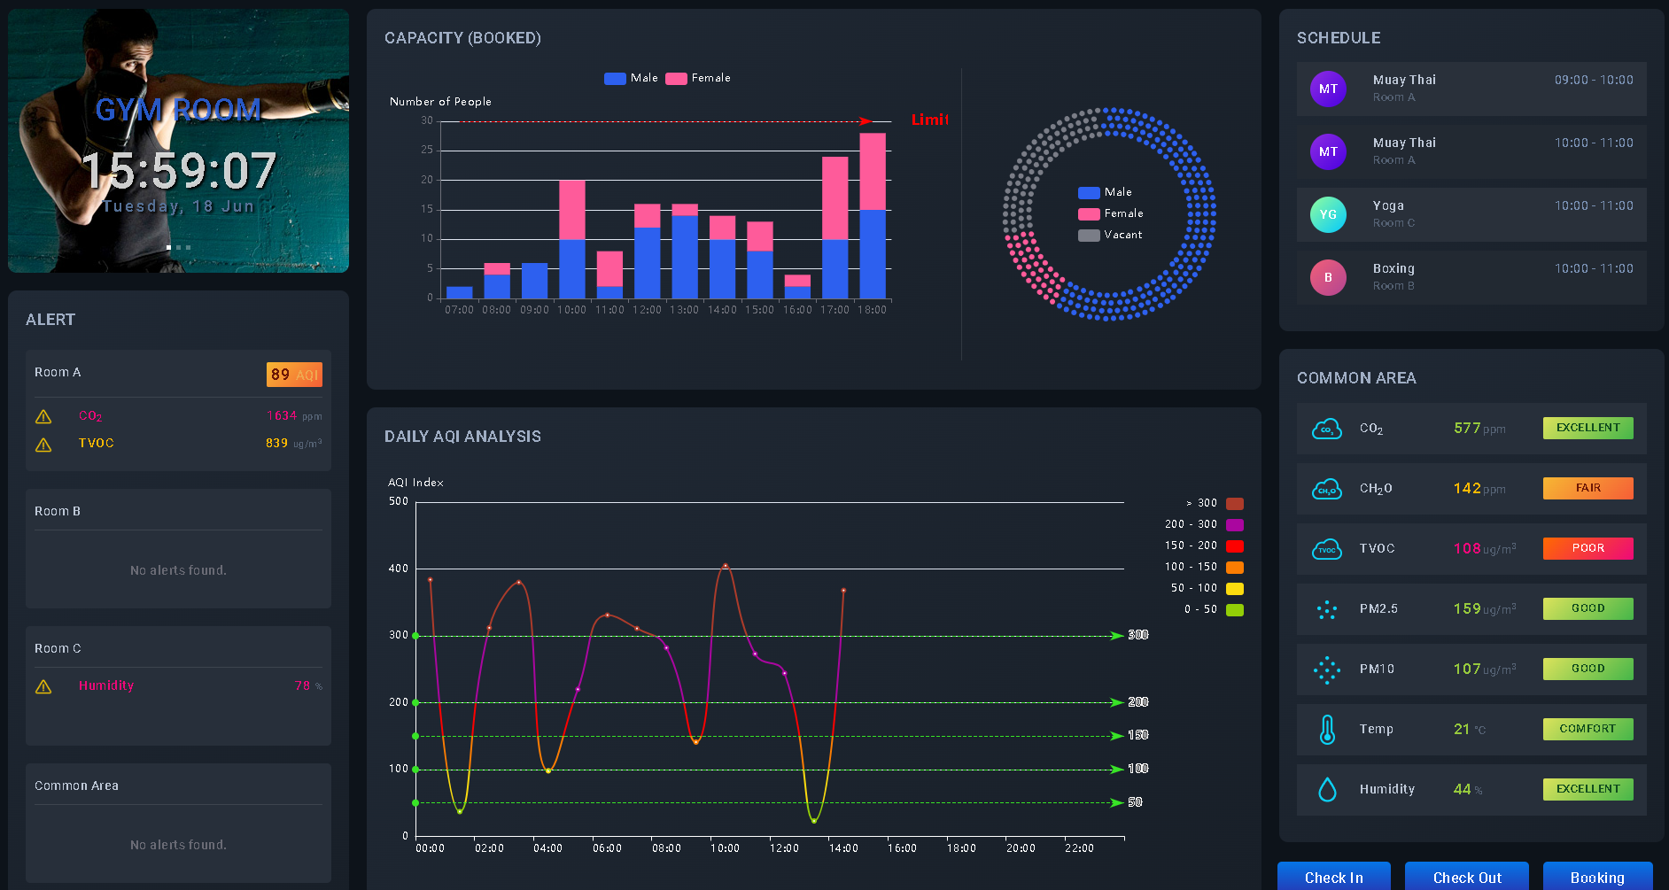
API integration
API support for integrations
  BMS,
  Custom dashboard.
  Third-party application
MQTT protocol for real-time data communication and integration with IoT platforms.
Custom Dashboard

Slide 14
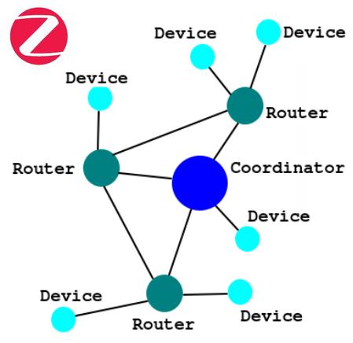
Zigbee/Thread ready*
Integrates compatible zigbee/thread devices to enhance standalone control capability
Aeris works as a zigbee network coordinator to control devices connected to it enhancing mesh network capability.
Zigbee network diagram
*Applicable to Model Aeris+ only

Slide 15
Future proofing
Aeris Lite features an expansion slot designed for add-on modules, facilitating the seamless integration of new sensors such as gas detectors, motion detectors and additional compliance functionalities. This capability not only enhances the current capabilities of Aeris Lite but also ensures readiness for future upgrades tailored to specific operational needs and regulatory requirements.
Aeris Lite

Slide 16
Current available add-on
Combined photoionization detector (PID) TVOC sensor, screen and battery add-on for SS554 compliance.
  PID TVOC sensor 10.6eV, 0-20ppm range, 2ppb resolution, ±5% accuracy.
  Li-Ion battery with embedded battery management system with up to 8hours run time.
  Full coloured LCD 1.8” Screen add-on
Combined screen and battery add-on for on-the-go monitoring.
  Li-Ion battery with embedded battery management system with up to 8hours run time.
  Full coloured LCD 1.8” Screen add-on
Carbon monoxide gas sensor add-on
  Electrochemical CO sensor, 0-500ppm range, 0.1ppm resolution, ±25% accuracy
Ozone gas sensor add-on
  Electrochemical O3 sensor, 0-10ppm range, 0.01ppm resolution, ±25% accuracy

Slide 17
Upcoming add-on
mmWave Human Presence sensor add-on
  24GHz frequency
  7 metres range
  Multiple zone detection
Speaker add-on
  Custom announcement capability

Slide 18

Global standards and framework
Compliant with SS554 (Singapore Standard for Indoor Air Quality)
  Compliant with indoor air quality audit sensor technology requirement for CO2, PM2.5, CH2O, Relative humidity, Temperature, TVOC*
Compliant with WELL building standards requirement.
  Monitors temperature, humidity, PM2.5, PM10, Formaldehyde, carbon dioxide
  A01 Air Quality
  A03 Ventilation Design
  A06 Enhanced Ventilation Design
  A08 Air Quality Monitoring and Awareness
  A13 Air filtration
  T01 Thermal performance
  T06 Thermal Comfort Monitoring
  T07 Humidity Control
  Aeris Lite can help compliance with preconditions A01, A03, and T01 and get up to 13 points for projects in A05, A06, A08, T06 and T07
Compliant with Leeds certification requirements.
  Monitors CO2, TVOC, PM2.5
  Get up to 10 points with continuous monitoring
*With Optional PID TVOC sensor

Slide 19

Cybersecurity and Certification
Certified under Singapore's Cybersecurity Labelling Scheme.
Ensures robust data protection and device security.

Slide 20

Developed in Singapore
Aeris Lite is a testament to Singaporean innovation and engineering excellence.
Proudly developed from the ground up right here in Singapore.
Benefits from our nation's strong focus on technology and quality assurance.

Slide 21

Sustainability in mind
Selective Laser Sintering, a 3D printing technology, enables Aeris Lite to be manufactured from highly recyclable nylon PA12 material, surpassing traditional moulded ABS in environmental benefits.
On-demand production minimizes environmental costs associated with inventory and shipping.
Minimal recyclable packaging is utilized to ensure environmental sustainability and minimize waste.

Slide 22
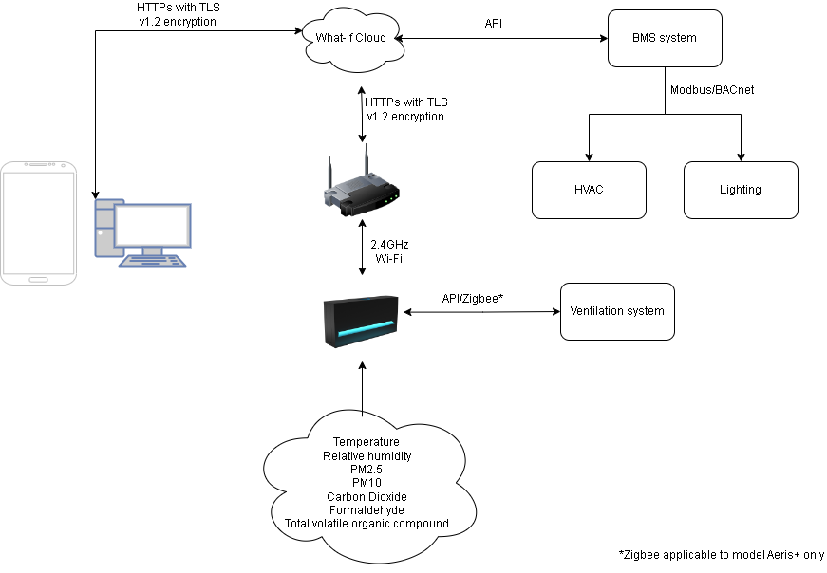
How It Works
Aeris Lite detects pollutants in the environment.
Data flow:
  Onboard processing applies compatible automations based on threshold criteria.
  Processed data is transmitted to the cloud.
  The Building Management System (BMS) receives real-time data from the cloud.
    BMS implements relevant countermeasures based on the received data.
Users access real-time data through a mobile app and dashboard connected to the cloud server.

Slide 23




Applications
Aeris Lite is designed to significantly enhance indoor air quality across a wide range of settings. By continuously monitoring and managing key air quality parameters, it helps create healthier environments that are conducive to well-being and productivity. Whether in healthcare facilities, commercial offices, educational institutions, or residential buildings, Aeris Lite ensures that the air you breathe is clean and safe. Its advanced features and connectivity options make it an indispensable tool for maintaining optimal air quality, thereby promoting health, comfort, and efficiency in any environment.
Healthcare Facilities: Maintains high air quality standards with advanced connectivity.
Commercial Offices: Promotes a healthy, productive environment with stylish decor.
Educational Institutions: Safe learning for students and staff, with robust data security.
Residential Buildings: Safe and comfortable living with sleek design.

Slide 24
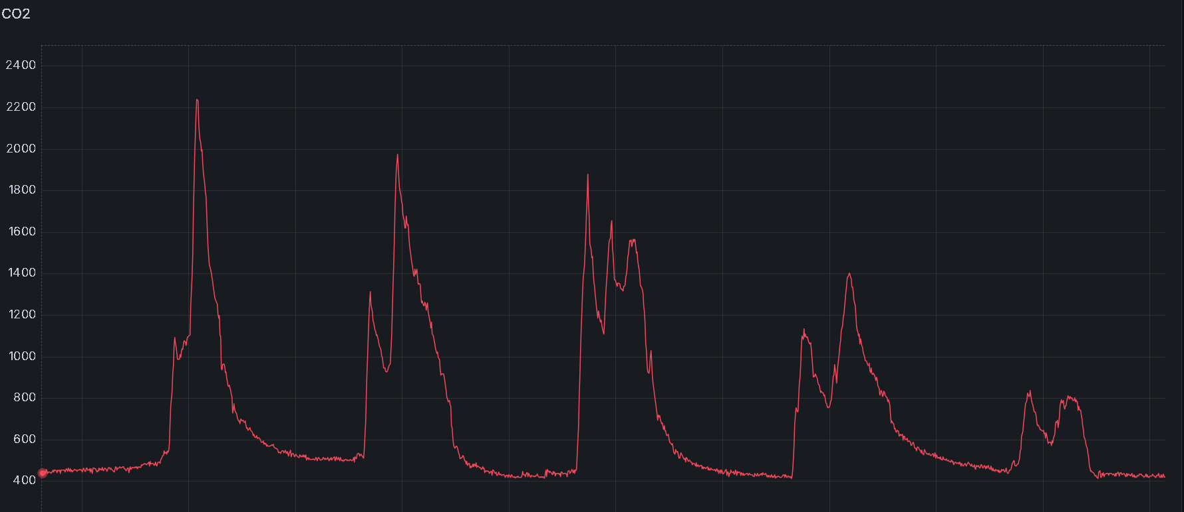
Case Study: CO2 and Formaldehyde Monitoring in Educational Institution
Overview:
  Location: Singapore
  Building Type: Educational Institution
  Challenge: High levels of CO2 and Formaldehyde affecting student health and learning outcomes.
Solution:
  Installed Aeris Lite IAQ sensors in newly renovated classroom to monitor CO2 and Formaldehyde levels in real-time.
  Utilized the Aeris’s Wi-Fi connectivity and Zigbee radio for seamless integration with the classroom's ventilation system.
  Leveraged the Aeris Lite app for real-time notifications and insights, enabling quick responses to air quality issues.
Results:
  Real-time data allowed for immediate adjustments to the ventilation system, reducing CO2 levels by up to 48% to more conducive level (2100ppm to 1100ppm in 15minutes during peak capacity hours).
  Formaldehyde levels were also brought down to safe limits (>0.1ppm) within two weeks through frequent ventilation activation, ensuring a healthier learning environment.
  Improved student concentration and reduced absenteeism due to better air quality.
  Positive feedback from teachers and parents regarding the enhanced air quality and learning conditions.
Conclusion:
  Aeris Lite proved to be an effective solution for monitoring and managing indoor air quality, significantly improving health and learning outcomes in the school.

Slide 25
Studies on PM2.5 monitoring
Study 1:
  Title: "Impact of PM2.5 on Cardiovascular Health in Urban Environments“
  Findings: Elevated PM2.5 levels are associated with increased risks of cardiovascular diseases, particularly among urban populations exposed to high traffic and industrial emissions.
Study 2:
  Title: "Long-Term Exposure to PM2.5 and Respiratory Health Effects“
  Findings: Prolonged exposure to PM2.5 particles can lead to respiratory issues such as asthma exacerbation and reduced lung function, highlighting the importance of continuous monitoring and mitigation strategies.
Conclusion: Consistently monitoring and managing PM2.5 levels is essential for sustaining healthy and productive indoor environments, especially within healthcare settings.

Slide 26
Studies on CO2 Monitoring
Study 1:
  Title: "The effects of elevated carbon dioxide on cognitive performance in office environments.“
  Finding: Elevated CO2 levels (above 1000 ppm) can impair cognitive function, affecting decision-making and problem-solving skills.
Study 2:
  Title: "Indoor carbon dioxide concentrations and related symptoms in elementary school children.”
  Finding: High CO2 levels in classrooms are linked to increased reports of headaches, drowsiness, and decreased attention span among students.
Conclusion: Continuous monitoring and managing CO2 levels are crucial for maintaining a healthy and productive indoor environment.

Slide 27
Studies on Formaldehyde Monitoring
Study 1:
  Title: "Health effects of formaldehyde exposure and the influence of air quality on indoor air quality in healthcare settings.“
  Finding: Elevated Formaldehyde levels are associated with increased respiratory issues and allergic reactions among patients and healthcare workers.
Study 2:
  Title: "Formaldehyde exposure in healthcare facilities: Sources, levels, and mitigation strategies.“
  Finding: Sources of Formaldehyde in hospitals include building materials, furniture, and medical equipment. Effective monitoring and ventilation strategies are critical to reducing exposure.
Conclusion: Continuous monitoring and control of Formaldehyde levels are essential for maintaining a safe and healthy indoor environment, particularly in healthcare settings.

Slide 28
Market comparison
 | Aeris Lite | Competitor A | Competitor B | Competitor C
Temperature | Yes | Yes | Yes | Yes
Relative Humidity | Yes | Yes | Yes | Yes
Carbon Dioxide (CO2) | Yes | Yes | Yes | Yes
PM2.5 | Yes | Yes | Yes | Yes
PM10 | Yes | No | Yes | No
Total Volatile Organic Compounds (TVOC) | Yes | Yes | Yes | Yes
Formaldehyde (CH2O) | Yes | No | Optional | No
Ozone (O3) | Optional | No | Optional | Optional
Carbon Monoxide (CO) | Optional | No | No | Optional
Configurable LED | Yes | No | No | No
Zigbee/thread radio | Yes* | No | No | No
Offline data storage | Yes | Yes | Yes | Yes
Mobile application | Yes | Yes | Yes | Yes
Automations | Yes | No | No | No
Alert and notification | Yes | No | No | No
Dashboard | Yes | Yes | Yes | Yes
Data export | Yes | Yes | Yes | Yes
BMS API integration | Yes | Yes | Yes | Yes
Optional add-on capability | Yes | No | Yes | Yes
CSA Cybersecurity certified | Yes | No | No | No
SS554 compliant | Yes** | Partial | Partial | Partial
Well certification compliant | Yes | Yes | Yes | Yes
Leed certification compliant | Yes | Yes | Yes | Yes
Pricing SGD RRP | $799 | $1,299 | $1,999 | $1,899
* Applicable to Model Aeris+ only
* Optional PID TVOC sensor

Slide 29
Future developments
Upcoming features:
  Expanded pollutant detection.
  Enhanced AI-driven analytics for action recommendations.
  Integration with more smart control ecosystems.
Partnerships:
  Collaboration with green building and sustainability organisations.

Slide 30

Q&A
Notes:
Optimal installation height: between 0.9m – 1.8m
Optimal sensing area: 250m2. Depending on area configuration, more sensors may be needed.
Installation: Aeris can be wall mounted or desk mounted
What is required? Wi-Fi internet access and power socket for 5V usb adapter
Can it be run offline? Should a location have limitation on internet access, solution such as hosting a local dashboard server can be offered. Contact us for more info.

Slide 31
Conclusion
Health and Safety: Continuous IAQ monitoring is essential for protecting the health and well-being of occupants by mitigating respiratory, cardiovascular, and other health risks associated with poor air quality.
Enhanced Productivity: Maintaining optimal air quality leads to improved cognitive function, concentration, and overall productivity in workplaces and educational institutions.
Compliance and Standards: Regular monitoring ensures adherence to global standards and regulatory requirements, supporting sustainability and safety certifications like WELL, LEED, and SS554.
Economic Benefits: Effective IAQ management reduces healthcare costs and building maintenance expenses, while enhancing occupant satisfaction and retention.
Environmental Control: Real-time data and alerts enable proactive management of indoor environments, ensuring comfort and preventing issues related to humidity, temperature, and pollutant levels.
By prioritizing indoor air quality monitoring, we create healthier, safer, and more productive indoor environments, ultimately enhancing the quality of life and well-being for all occupants.

Slide 32
Aeris Lite Features and benefits
Comprehensive monitoring with seven key parameters.
Developed from the ground up in Singapore.
Certified cybersecurity.
Seamless Wi-Fi connectivity and support for Thread/Zigbee radio.
Efficient BMS integration with API and MQTT support.
Industrial aesthetics, functional and sleek.
User defined automations and threshold
Mobile Application: Monitor real-time data, receive alerts, and manage settings conveniently via the Aeris Lite mobile app.
Dashboard: Visualize real-time air quality metrics, historical data trends.

Slide 33
Contact Us
Website: https://aeris.what-if.sg
Email: aeris@what-if.sg

